Slide 1

Operating Systems
BCSC 0004
CPU Scheduling
First Come First Serve
(FCFS)

Slide 2
CPU Scheduling Criteria
Throughput: It is the total number of processes completed per unit time or rather say total amount of work done in a unit of time. This may range from 10/second to 1/hour depending on the specific processes.
Turnaround Time: It is the amount of time taken to execute a particular process, i.e. the interval from time of submission of the process to the time of completion of the process (Wall clock time).
Waiting Time: The sum of the periods spent waiting in the ready queue amount of time a process has been waiting in the ready queue to acquire get control on the CPU.

Slide 3
CPU Scheduling Criteria cont…
Load Average: It is the average number of processes residing in the ready queue waiting for their turn to get into the CPU.
Response Time: Amount of time it takes from when a request was submitted until the first response is produced. Remember, it is the time till the first response and not the completion of process execution (final response).
In general CPU utilization and Throughput are maximized and other
factors are reduced for proper optimization.
CPU Utilization: To make out the best use of CPU and not to waste any CPU cycle, CPU would be working most of the time (Ideally 100% of the time).
Considering a real system, CPU usage should range from 40% (lightly loaded) to 90% (heavily loaded).

Slide 4
CPU Scheduling Algorithms
First-Come, First-Served (FCFS) Scheduling
Shortest-Job-Next (SJN) Scheduling
Priority Scheduling
Shortest Remaining Time
Round Robin(RR) Scheduling
Multiple-Level Queues Scheduling

Slide 5
First-Come, First-Served (FCFS) Scheduling
Jobs are executed on first come, first serve basis.
It is a non-preemptive scheduling algorithm.
Easy to understand and implement.
Its implementation is based on FIFO queue.
Poor in performance as average wait time is high.

Slide 6
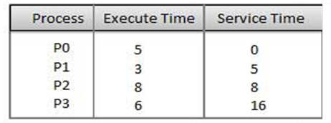
First-Come, First-Served (FCFS) Scheduling

Slide 7
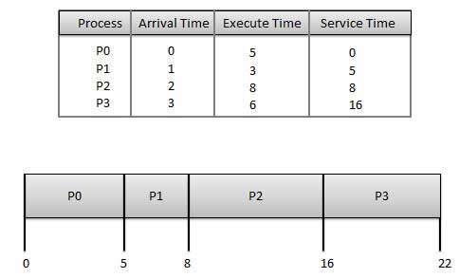
First-Come, First-Served (FCFS) Scheduling

Slide 8
First-Come, First-Served (FCFS) Scheduling
Process | Turnaround Time | Wait Time : Turnaround Time - Burst Time
P0 | 5-0=5 | 5-5=0
P1 | 8-1=7 | 7-3=4
P2 | 16-2=14 | 14-8 = 6
P3 | 22-3=19 | 19 - 6 = 13
Average Wait Time: (0+4+6+13) / 4 = 5.75

Slide 9
FCFS Example
Process Burst Time
P₁ 24
P₂ 3
P₃ 3
Suppose that the processes arrive in the order: P₁ , P₂ , P₃
The Gantt Chart for the schedule is:
Waiting time for P₁ = 0; P₂ = 24; P₃ = 27
Average waiting time: (0 + 24 + 27)/3 = 17
P₁
P₂
P₃
0
24
27
30

Slide 10
FCFS Example
Suppose that the processes arrive in the order
P₂ , P₃ , P₁
The Gantt chart for the schedule is:
Waiting time for P₁ = 6; P₂ = 0; P₃ = 3
Average waiting time: (6 + 0 + 3)/3 = 3
Much better than previous case
Convoy effect short process behind long process
P₂
P₃
P₁
0
3
6
30

Slide 11
FCFS
PROCESS | ARRIVAL TIME | BURST TIME
P1 | 0 | 8
P2 | 1 | 5
P3 | 2 | 2
P4 | 3 | 4

Slide 12


